Slide 1
NPTEL
Video Course on Machine Learning
Professor Carl Gustaf Jansson, KTH
Week 6 Machine Learning based
on Artificial Neural Networks
Video 6.3 Model of a Neuron in an ANN

Slide 2
Structure of Lectures in week 6
L1 Fundamentals of
Neural Networks
McCulloch and Pitts
Supervised learning L2 Perceptrons Linear L6 Hebbian Learning and
- classification classification Associative Memory
- regression
L3 och L4 Feed forward multiple layer Reinforcement
We are here now networks and Backpropagation learning Unsupervised learning
L5 Recurrent Neural Sequence and L7 Hopfield Networks and
Perception Networks (RNN) temporal data Boltzman Machines
L8 Convolutional Neural
Networks (CNN)
L9 Deep Learning and
recent developments
Development of
the ANN field
L10 Tutorial on assignments

Slide 3
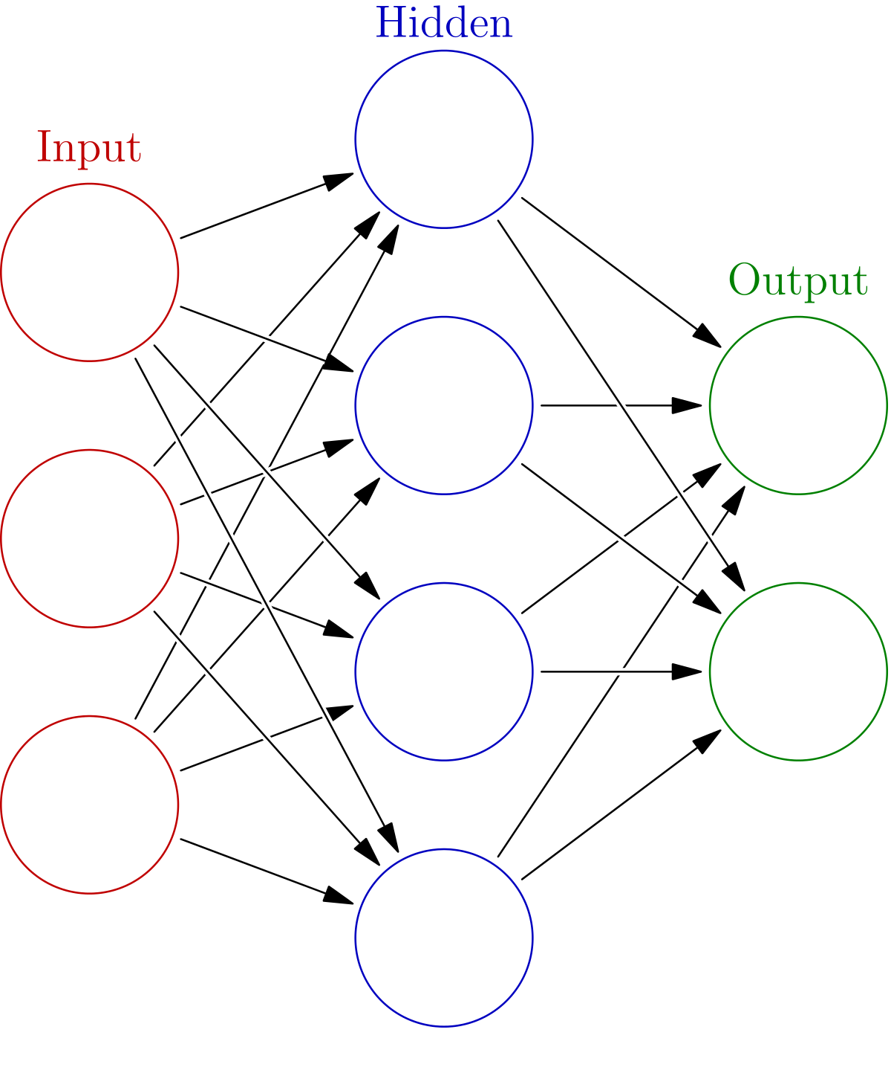
An Artificial Neural Network
An Artificial Neural Network has typically many Neurons and several layers in contrast to the Single Neuron Perceptron.
In this lecture we will still study a single neuron but of the kind that builds up complex networks.
We will look at how the Neuron performs in a forward feeding manner and how its input weights are updated in each cycle. We will use the same kind of examples as we used for the perceptron.
Even if we study the Neuron in isolation it will perform in the same manner as part of a larger Network. An ANN network consists of units and connections between units, A is considered the predecessor of B and B the successor of A. The output of A is the input of B.
The behaviour of Input and Output units are special in the sense that they simple output the external input without any processing. They are introduced to create a homogeneous model.
A
B

Slide 4
Abstract model of an ANN Neuron
Xn
Wn
Y = if Sum>0 then f (Sum) else 0
f = activation function
W2
X2
Sum = Sum (Wi*Xi)
i=1..n
Target value = T
for the output
W1
X1
The differences between the T and Y values is the basis for an error estimate = E
W0=
- Treshold
X0=1

Slide 5
The core computation of an ANN unit
We identify the studied Neuron by j. All parameters have Real values.
2. The Neuron j has a number of inputs i= 1...n.
3. Each connection is assigned a Weight wij.
4. Each node has an activation Threshold T
5. Typically the Threshold is remodelled as its negation and named Bias. An extra input x0 is added with
constant value = 1. The weight x0j is set to the Bias or –Threshold. This move enables the Bias to be
adapted in the same fashion as weights.
6. The weighted inputs are summed: Sum = Sum wij * ai
i=0..n
7. If Sum > 0 the output of unit j is calculated as
Y = f ( Sum ) where f is a so called activation or transfer function.
Y = 0 otherwise.

Slide 6
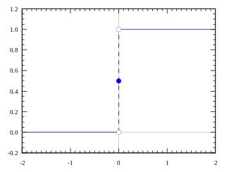
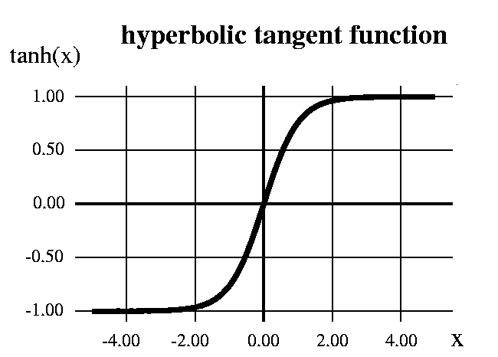
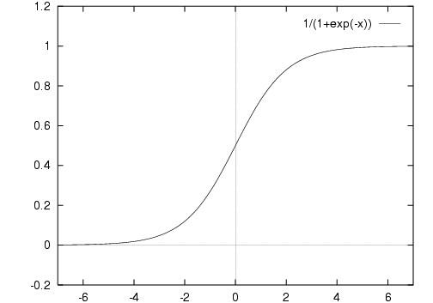
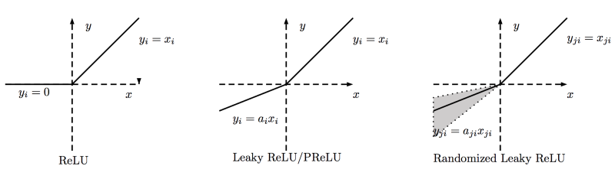
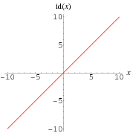
Selection of Activation or Transfer Functions
Step function
Sigmoid
Identity function
ReLU = Rectified Linear Unit

Slide 7
Properties of Activation or Transfer Functions
Another synonym is squashing function derived from the fact that certain activation functions squashes or saturates the values at the asymptotic end.
Nonlinear – when the activation function is non-linear, then a two-layer neural network can be proven to be a universal function estimator. The identity activation function does not satisfy this property.
Having finite range – when the range of the activation function is finite, gradient-based training methods tend to be more stable and efficient ( in many cases ranges are 0…1 or -1... 1)
Continuously differentiable – this property is desirable for enabling gradient-based optimization methods.
Monotonic – when the activation function is monotonic, the error surface associated with a single-layer model is guaranteed to be convex.
Smooth - functions with a monotonic derivative are advantageous for stability and efficiency
Approximating an identity function near the origin - will learn efficiently when its weights are initialized with small random values.
Most feed foward methods with learning based on gradient methods have the following problem:
- the vanishing gradient

Slide 8
The Vanishing Gradient Problem
The vanishing gradient problem is a difficulty found in training artificial neural networks with gradient-based learning methods and backpropagation.
In such methods, each of the neural network's weights receives an update proportional to the partial derivative of the error function with respect to the current weight in each iteration of training.
The problem is that in some cases, the gradient will be vanishingly small, effectively preventing the weight from changing its value.
The sources of the problem are that many activation functions have gradients in the range of (0..1) and these are combined using the chain rule.
.
The problem was first highlighted by Hochreiter in 1991. the problem does not only affect feed forward multiple layered networks, but also recurrent networks. The latter are trained by unfolding them into very deep feedforward networks, where a new layer is created for each time step of an input sequence processed by the network.

Slide 9
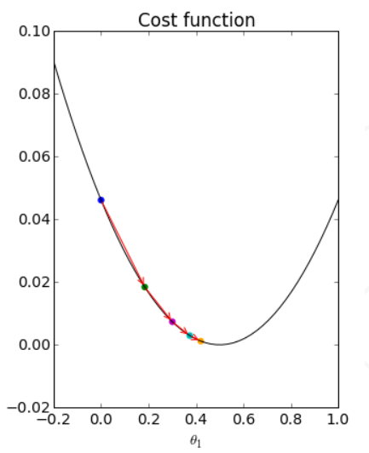
Delta Learning Rule
The Delta Learning Rule can be used when we have a Target T as a reference for the output Y.
The error measure is E= ½ * ( T-Y) ^2
The Delta Learning Rule can be inferred by applying a
gradient descent algorithm calculating the derivatives of
the error function E with respect to the weights W.
d Ej / d W ji = d (1/2* (T-Y)^2)/ d W ji - > Delta rule
The Delta rule becomes:
W j i =Wj i+ α *(Tj-Yj) G´(SUMj)*Xi
= learning rate parameter.
Yj = output from neuron j, T j = target for neuron j
W j i =weights between input i and neuron j,
X i = input # i
SUMj = weighted sum of inputs to neuron j,
G´ = derivative of transfer function for j
If the activation function is linear the Delta rule is simplified.
Wj i =W j i+ α *(Tj-Yj) *X i

Slide 10
Single Neuron Excitation
The activation function f is ReLU
If Sum wij * xi > 0 the output of unit j is calculated as
Y = f ( Sum (wij * xi) ) otherwise Y=0.
W j i =Wj i+ α *(Tj-Yj) G´(SUMj)*Xi
Wj i =W j i+ α *(Tj-Yj) *X i if f is linear.
X1=0.8 X2=0.3 T1= 0.26 W11=0.4 W21=-0.2 W01=-0.1, α=1 , Treshold = 0.1 -> Bias =-1
The segments are differentiable
0.8
0.4
Y1
0.4*0.8 + -0.2*0.3 – 1* 0.1 =0 .16 > 0 -> Y1 = f(0.16)=0.16
0.3
-0.2
W11=0.4+1*(0.26-0.16)*0.8 = 0.48 W12= -0.2 +1*(0.26-0.16) *0.3= - 0.17
W00=-0.1 + 1*(0.26-0.16)*1= 0
1
-0.1

Slide 11
Example
If Sum wij * xi > 0 the output of unit j is calculated as
Y = f ( Sum (wij * xi) ) otherwise Y=0.
W j i =Wj i+ α *(Tj-Yj) G´(SUMj)*Xi
Wj i =W j i+ α *(Tj-Yj) *X i if f is linear.
Delta Weight
Assume a single neuron:
with 3 inputs plus 1 for bias
with a learning rate a=1
initial weights all 0 including initial bias
Training set
0 0 1 -> 0
1 1 1 -> 1
1 0 1 -> 1
The activation function f is ReLU
Instance Target Weight Vector Sum Output Delta Weight
0 0 1 1 0 0 0 0 0 0 0 0 0 0 0
1 1 1 1 1 0 0 0 0 0 0 1 1 1 1
1 0 1 1 1 1 1 1 1 3 3 -2 0 -2 -2
-1 1 -1 -1

Slide 12
NPTEL
Video Course on Machine Learning
Professor Carl Gustaf Jansson, KTH
Thanks for your attention!
The next lecture 6.4 will be on the topic:
Learning in a Feed Forward
Multiple Level ANN: Backpropagation

